Slide 1

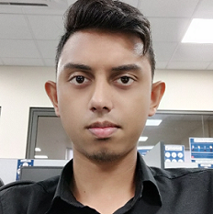

Experience
Areas of expertise
Functional
Software engineering
Analytical Abilities
Agile/Design Thinking
Testing Abilities
Technical
Power BI
Google Big query/Data Studio
Reporting
Oracle, PLSQL
Asp.net C#/VB
SQL Server
Html, CSS
JS
Java
Php
Application Development Associate( Sep 2021 - Present)
Azure Fundamentals
Power Bi learning path & training for 1+ month
Certification preparation for DA-100
SAP ABAP bootcamp training
Thahil SEETHIAH
Data Analyst
Application Development Associate Ebène, Mauritius.
Certification
Trainee Developer( Oct 2020 – Sep 2021)
Report/Visualization development using Google Data Studio
Oracle database development with PLSQL
AZ-900 Azure Fundamentals
(2022)
Professional background
Oracle software development & maintenance for 7+ months
Including a bit of reporting using Google Data Studio.
Aspiration
Data Engineering
I want to learn more on BI, Data Warehousing and ETL using the various technologies available today.
Education
BSc(Hons) Software Engineering
University of Technology Mauritius, 2017-2020

Slide 2

Past Experience
Trainee Developer at Lottotech LTD (Oct 2020 – Sep 2021)
Worked with MIS Team to provide important information to other users through development of inhouse solutions.
Worked with Oracle , Apex to improve and implement changes to current systems/packages using PL/SQL.
Developed dashboards and reports to view activities and actions happening on mobile app using Firebase, Google Data Studio and Big Query.
Internship at Starlink Business Solutions (Aug 2019 - Nov 2019)
Worked in web-based ERP system development using HTML, PHP,JS
Worked on a couple of Wordpress websites including their search engine optimization.

